Slide 1


Slide 2


Family GPS Tracker
PMAS-Arid Agriculture University- Rawalpindi University Institute of Information Technology
Jawad Ahmed 18-Arid-3020
Hassaan Ahmed 18-ARID-3016
Supervisor : Ms. Farkhanda Qamar

Slide 3

Contents
Introduction
Existing System
Problem Statement
Problem Solution
Project Scope
Project Objective
Diagrams - Use case, Erd, Class, Component, Activity
Tools and Technologies
Task Distribution
Screenshots
Future Project Schedule
University Institute of Information Technology, PMAS-Arid Agriculture University- Rawalpindi

Slide 4
Introduction
It is an android application which keeps you linked with your family members all the time.
This app helps you keep track of your loved one’s location in real-time to protect them and it helps them stay safe.
University Institute of Information Technology, PMAS-Arid Agriculture University- Rawalpindi

Slide 5
Existing System
There exists some existing system related to our project are as follows:
Google Family Link is a family parental controls app by Google that is designed for child safety and parental control. You can install this app to monitor your family members throughout the day. It doesn’t have a geo-fencing feature.
GeoLocator-Family Tracker is the smartphone app that helps to track your child's movements every day, and helps the family keep each other informed of their locations. It has no option like panic button to send help alert in case of emergency.
University Institute of Information Technology, PMAS-Arid Agriculture University- Rawalpindi

Slide 6
Problem Statement
The cases related to abductions and missing persons continue to rise which has been highly alarming .
There are already applications that provide location tracking features but those applications are mostly paid.
University Institute of Information Technology, PMAS-Arid Agriculture University- Rawalpindi

Slide 7
Proposed Solution
The proposed application will facilitate family member’s monitoring by providing
GPS location tracking features.
Unlike other existing systems, this application will provide all these features free of cost.
University Institute of Information Technology, PMAS-Arid Agriculture University- Rawalpindi

Slide 8
Project Scope
The app will include the functionality of getting child’s real-time location.
The app will have the option for creating safe zones for family members.
The app will have the option for viewing location history of family members.
The app will Allow family members to send help alert in case of emergency.
University Institute of Information Technology, PMAS-Arid Agriculture University- Rawalpindi

Slide 9
Project Objectives
To achieve peace of mind for parents.
To lower the rate of kidnapping cases.
To ensure the safety of loved ones.
University Institute of Information Technology, PMAS-Arid Agriculture University- Rawalpindi

Slide 10
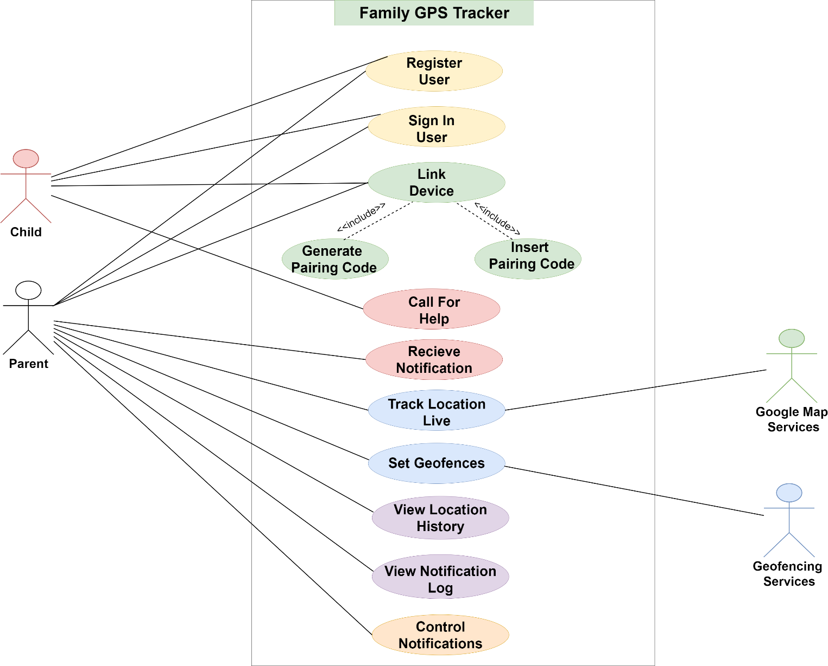
Diagrams -Use Case Diagram
University Institute of Information Technology, PMAS-Arid Agriculture University- Rawalpindi

Slide 11
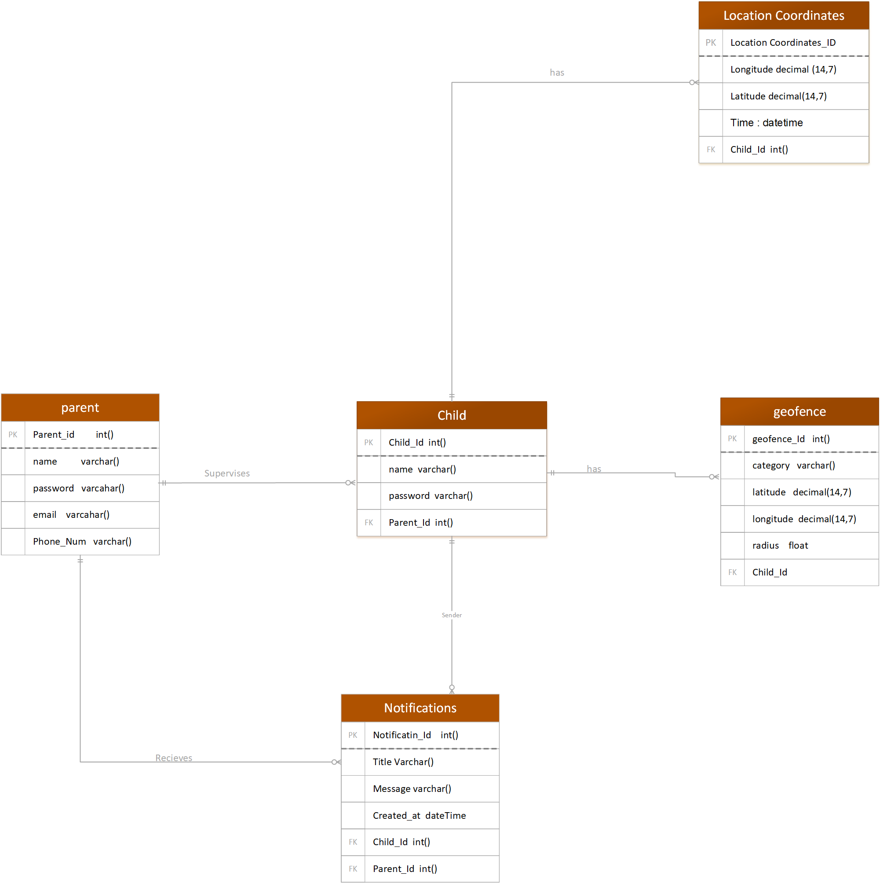
Diagrams –Erd Diagram

Slide 12
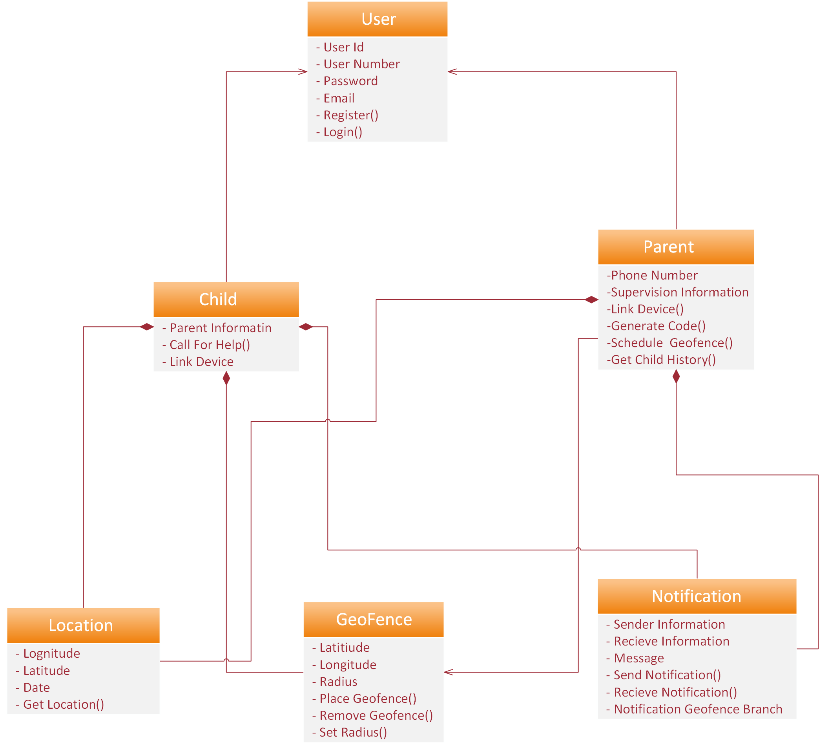
Diagrams –Class Diagram

Slide 13
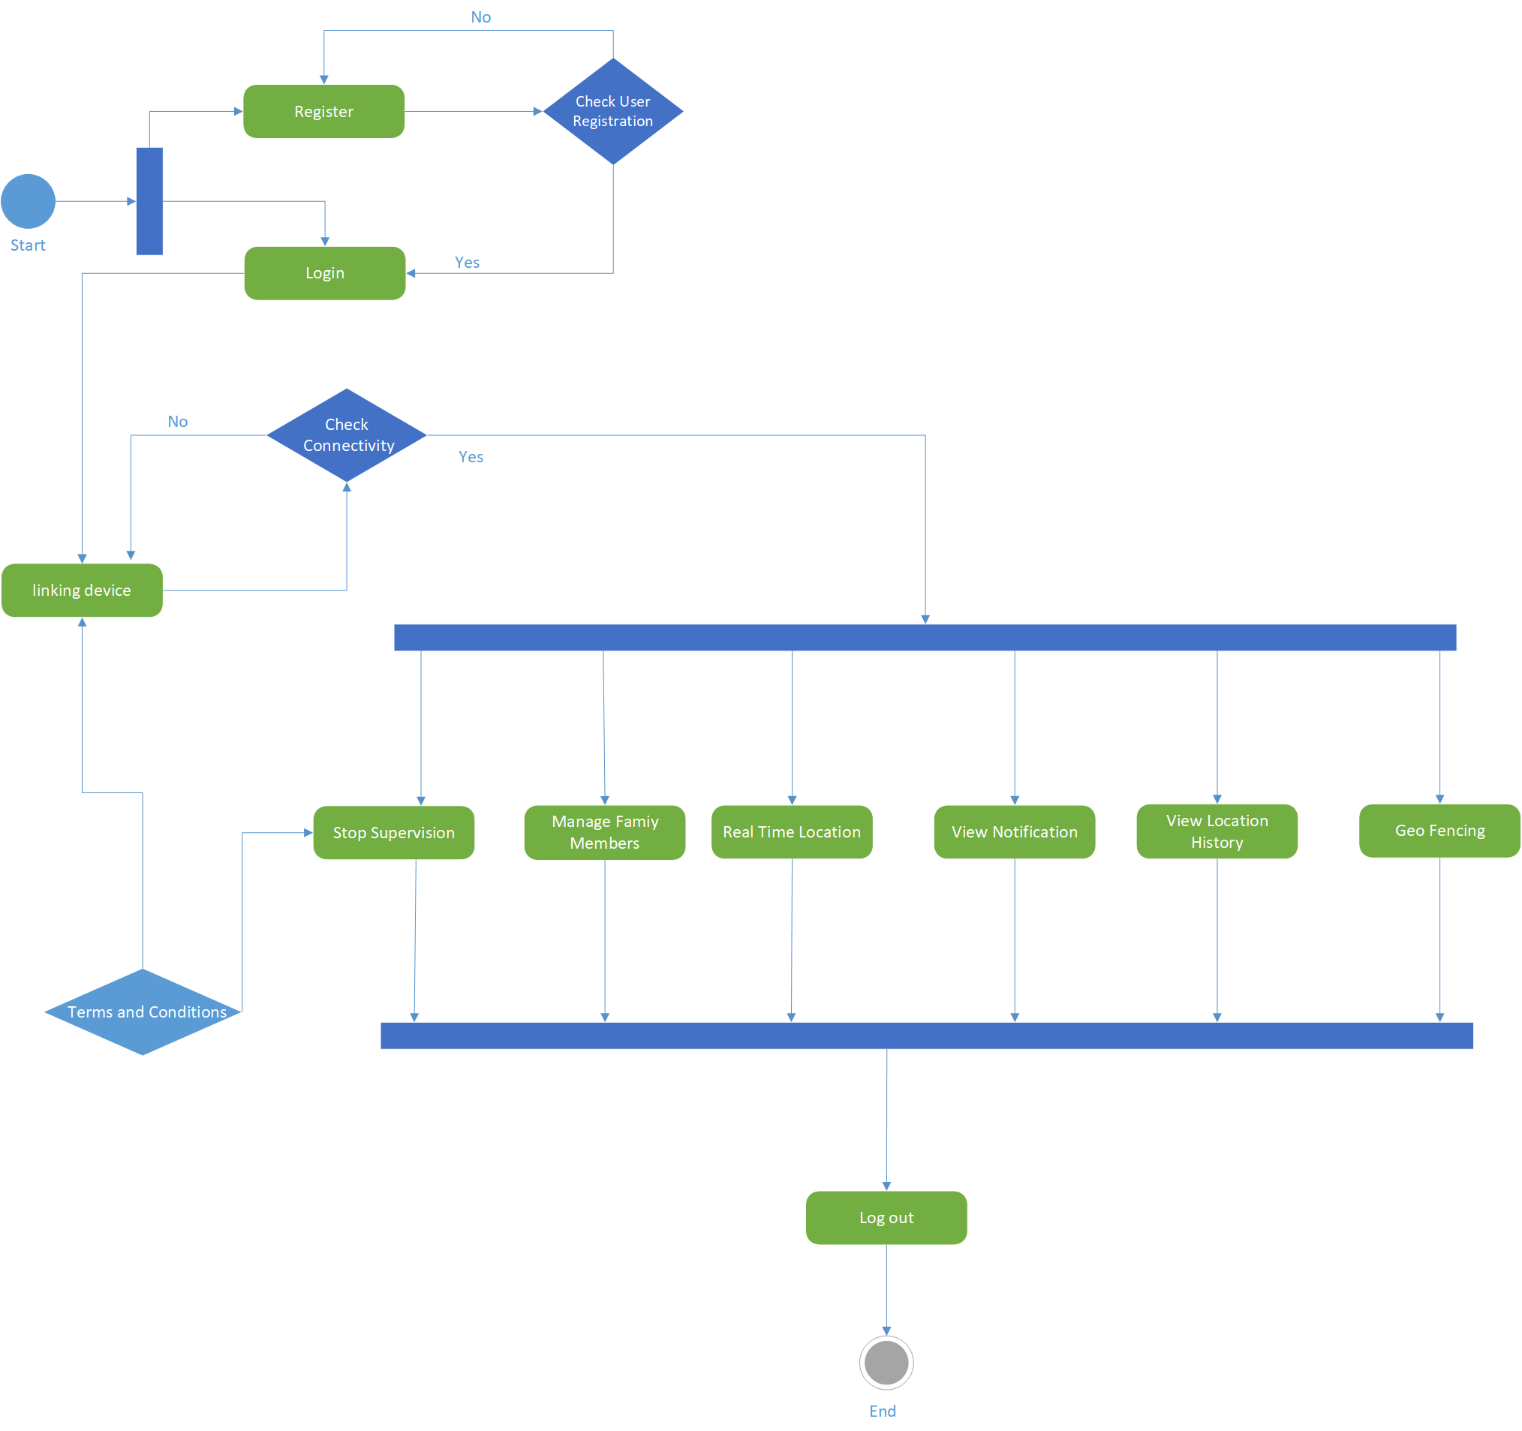
Diagrams –Activity Diagram

Slide 14
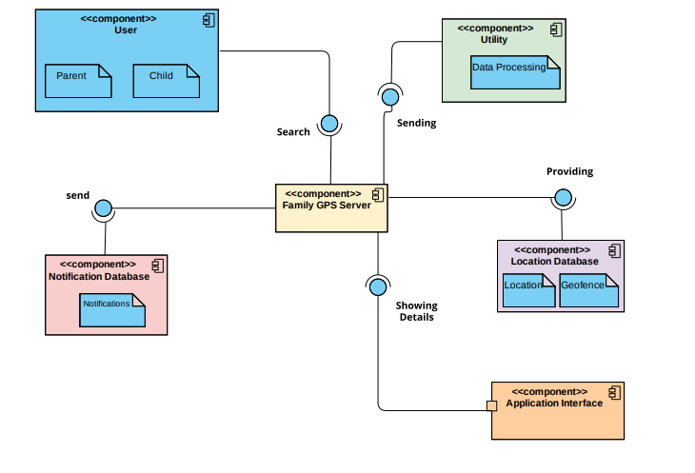
Diagrams –Component Diagram

Slide 15
Tasks Distribution
Group Members | Responsibilities
Jawad Ahmed | Designing Database, Coding Designing Interfaces , Form validations Documentation
Hassaan Ahmed | Logo Design Designing Interfaces- SignUp Form and SignIn Form Documentation
University Institute of Information Technology, PMAS-Arid Agriculture University- Rawalpindi

Slide 16





Tools & Technologies
University Institute of Information Technology, PMAS-Arid Agriculture University- Rawalpindi

Slide 17
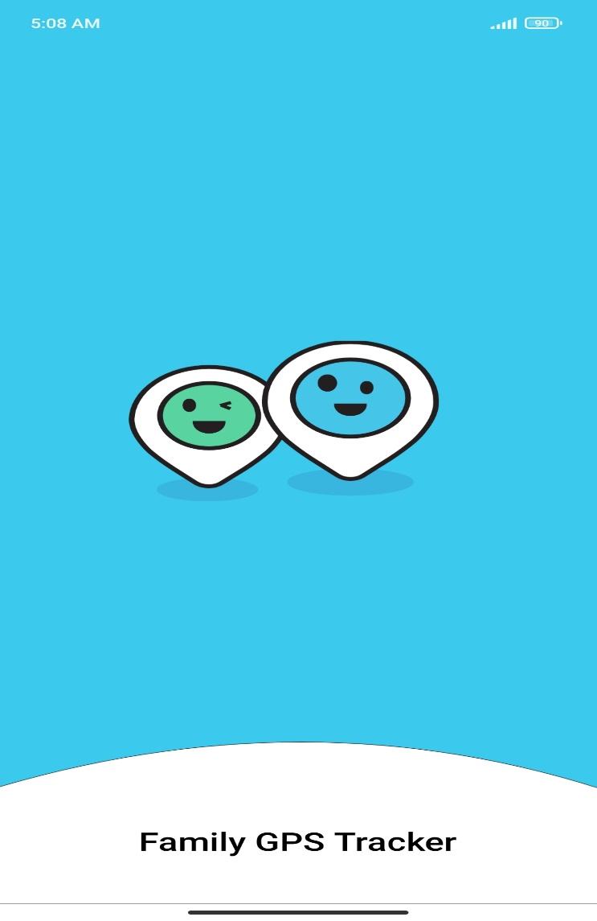
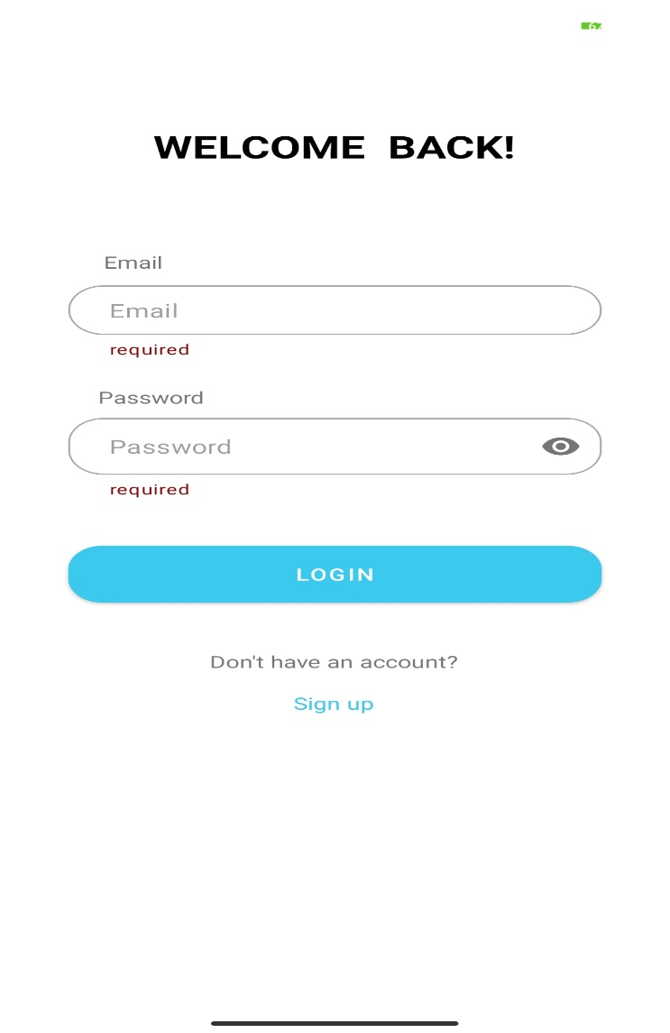
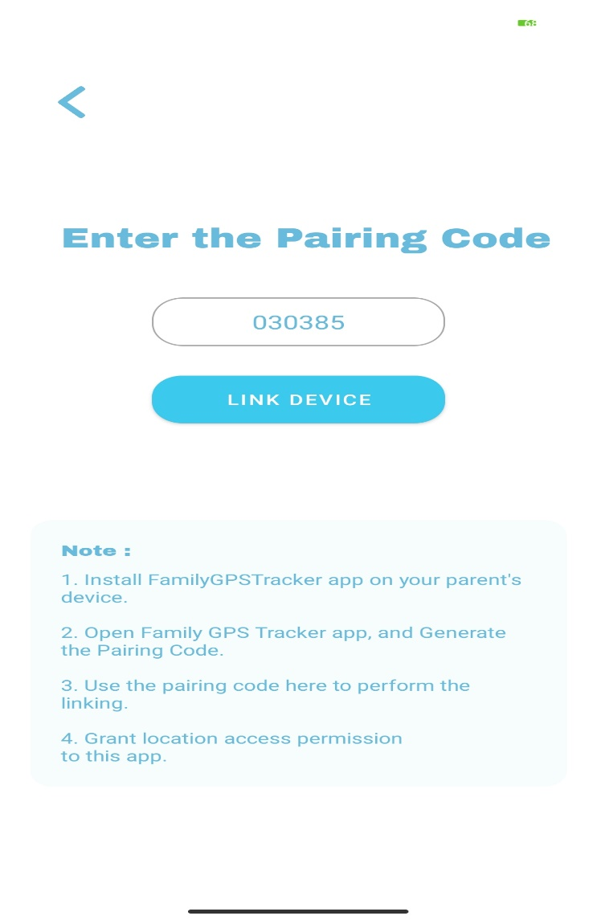
Screen Shots
University Institute of Information Technology, PMAS-Arid Agriculture University- Rawalpindi

Slide 18
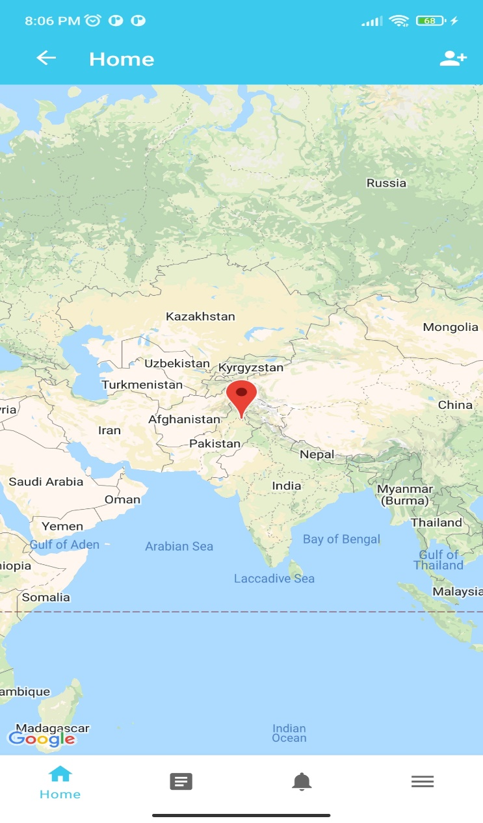
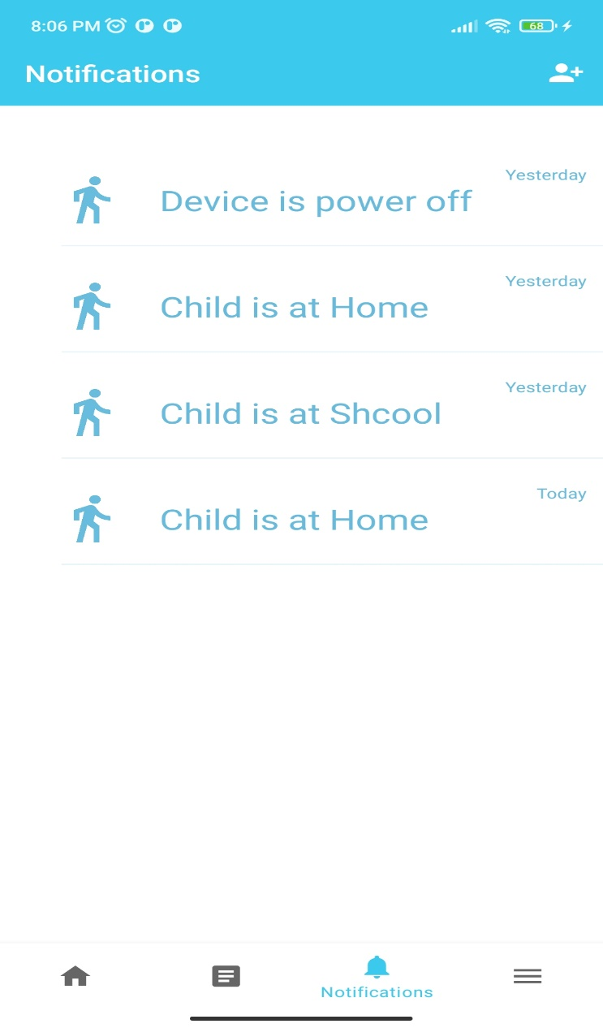
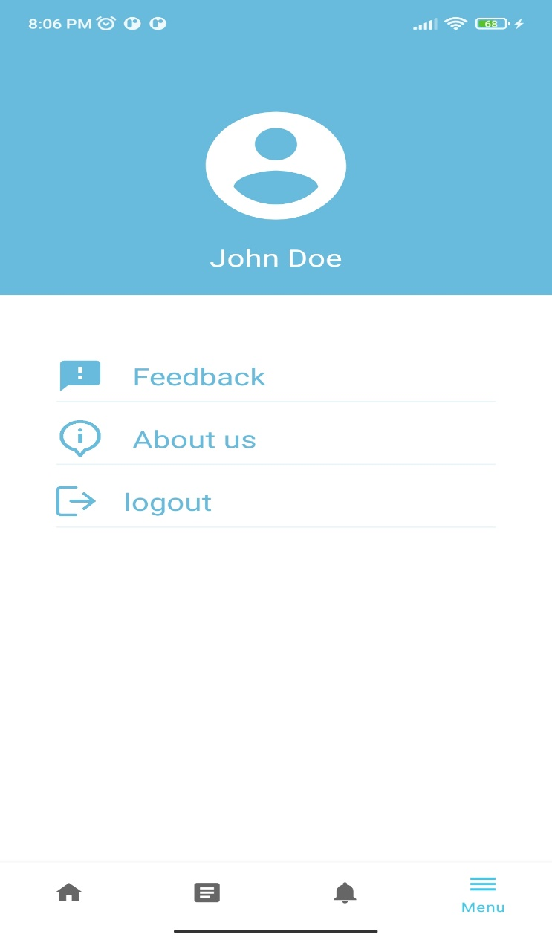
Screen Shots
University Institute of Information Technology, PMAS-Arid Agriculture University- Rawalpindi

Slide 19
Future Project Schedule
Tasks | Schedule
Design & Coding of Project Design All Screen Layouts Smart Alert Module Location Tracking Module Rest webservices developement | 26th January To 5th March 2022
Creating Reports | 7th March to 20th March 2022
Testing of Project Module wise & Finishing the Code | 25th March To 20th April 2022
Integrating Project | 25th April 2022 To 10th May 2022
Testing of Project | 11th May To Finsih Date
University Institute of Information Technology, PMAS-Arid Agriculture University- Rawalpindi

Slide 20


